Slide 1

Financial Analytics
Group - 09

Slide 2





Meet the Team
Santhosh​
Narapareddy​
​
Rituraj​
Borah
Vidya​
Biradar
Bhavita ​
Bhatt ​
Sai Ganesh ​
Darisa​

Slide 3
Introduction
JPMorgan Chase & Co., commonly known as JPMorgan or simply JPM, is a multinational investment bank and financial services company headquartered in New York City.
It is one of the oldest and largest financial institutions in the United States, with roots tracing back to the founding of The Manhattan Company in 1799.
The company has a rich history of mergers and acquisitions, including the merger of Chase Manhattan Corporation and J.P. Morgan & Co. in 2000, forming what is now known as JPMorgan Chase & Co.
Notes:
JPMorgan Chase & Co commonly known as JPMorgan or simply JPM, is a multinational investment bank and financial services company headquartered in New York City.
It is one of the oldest and largest financial institutions in the United States, with roots tracing back to the founding of The Manhattan Company in 1799.
The company has a rich history of mergers and acquisitions, including the merger of Chase Manhattan Corporation and J.P. Morgan & Co. in 2000, forming what is now known as JPMorgan Chase & Co.

Slide 4
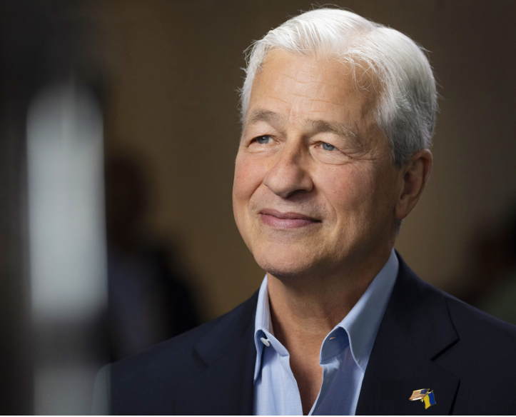
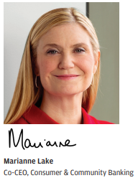
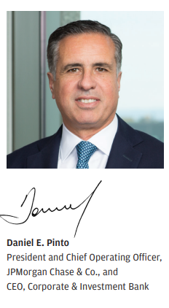
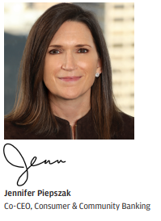
Key Managing Personnel
Jamie Dimon - Chairman and Chief Executive Officer
Notes:
Company’s CEO is Mr. Jamie Dimon
He is an American billionaire banker and business executive.
He has been the chairman and chief executive officer of JPMorgan Chase since 2006.
He began his career as a management consultant at Boston Consulting Group from 1979 to 1982
Daniel E. Pinto President and Chief Operating Officer for JPM and CEO for Corporate and Investment Bank.
Marianne Lake and Jennifer Piepszak, Co CEOs for Consumer & Community Banking.
Top Individual Shareholders are Jamie Dimon, Daniel Pinto and Mary Callahan.
Top Institutional Shareholders are Vanguard, BlackRock, StateStreet.

Slide 5

Purpose
Vision
Values
Notes:
Purpose – Vision - Values

Slide 6
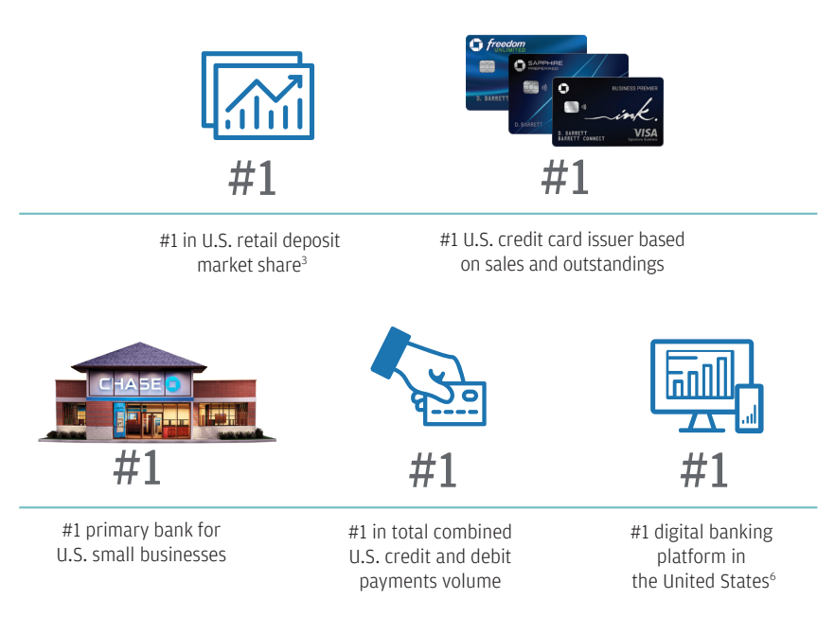
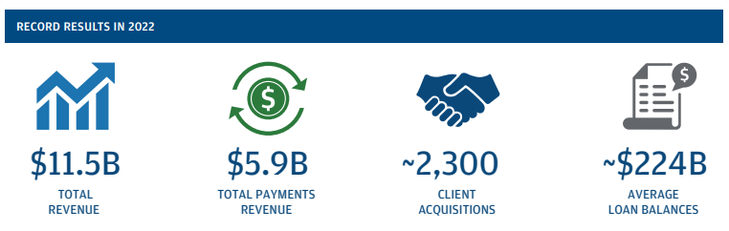
Market Leadership
Notes:
JP Morgan and Chase has been #1 in a lot of areas.

Slide 7
AI, DATA AND JOURNEY TO THE CLOUD
AI Utilization: Over 300 AI use cases cover risk management, marketing, and fraud prevention.
Human Resources: With 1,000+ staff, including 900 data scientists and 600 ML engineers, the company invests heavily in AI expertise. empower employees with AI through human-centered collaborative tools and workflow, leveraging tools like large language models, including ChatGPT.
Research and Ethics: A dedicated AI research team, focused on finance, ensures innovation, supported by ethicists for responsible AI application.
Cloud Infrastructure: A $2 billion investment in cloud data centers with 38% application migration signals a strategic shift toward cloud-native solutions.
Collaborative Approach: Collaboration between tech groups and management is key for their successful cloud system implementation.
Notes:
With the advancement in recent AI technology, JPMorgan Chase has embraced the change and created dedicated teams of data scientists and researchers. Also, they have heavily invested to upgrade their existing infrastructure to cope with these changes.

Slide 8
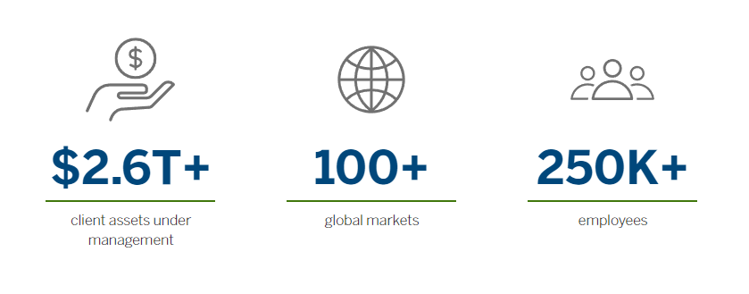
Current Operations
Operations Overview:
Consumer & Community Banking (CCB)
Corporate & Investment Bank (CIB)
Commercial Banking
Asset & Wealth Management (AWM)
Corporate Segment
Key Focus Areas:
Innovation
Risk Management
Customer-centric approach
Notes:
They currently manage over 2.6 trillion in client assets,
Pause
have a global presence in over 100 markets
Pause
with workforce exceeding 250,000 employees.

Slide 9
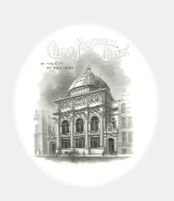
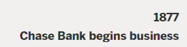


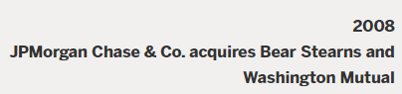
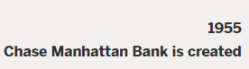
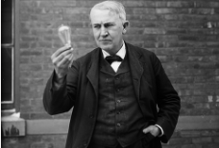
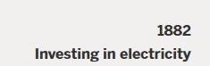

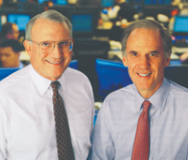
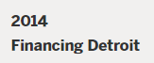
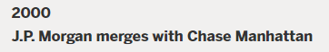

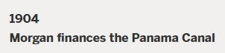
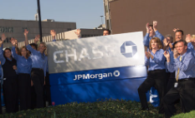
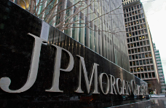
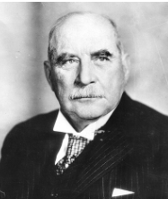
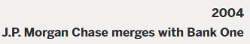
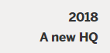
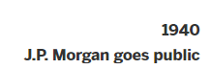
Growth – Mergers - Acquisitions
Notes:
1877 – Chase Bank Begins Business
1882 – Invested in Electricity with Thomas Alva Edison’s company – Edison Electric Illuminating Company
1904 – Panama canal is Financed by the bank
1940 – Company Goes Public
1955 – Chase Manhattan Bank is Created
2000 – Merger with Chase Manhattan
2004 – Merger with Bank One
2008 - Merger with Bear Sterns and Washington Mutual after collapse of housing and mortgage markets to save the market.
2014 – Financing Detroit – 100 Million USD over five years to support Detroit economy.
2018 – New HeadQuarters – New York – Building will house all NYC midtown employees.

Slide 10
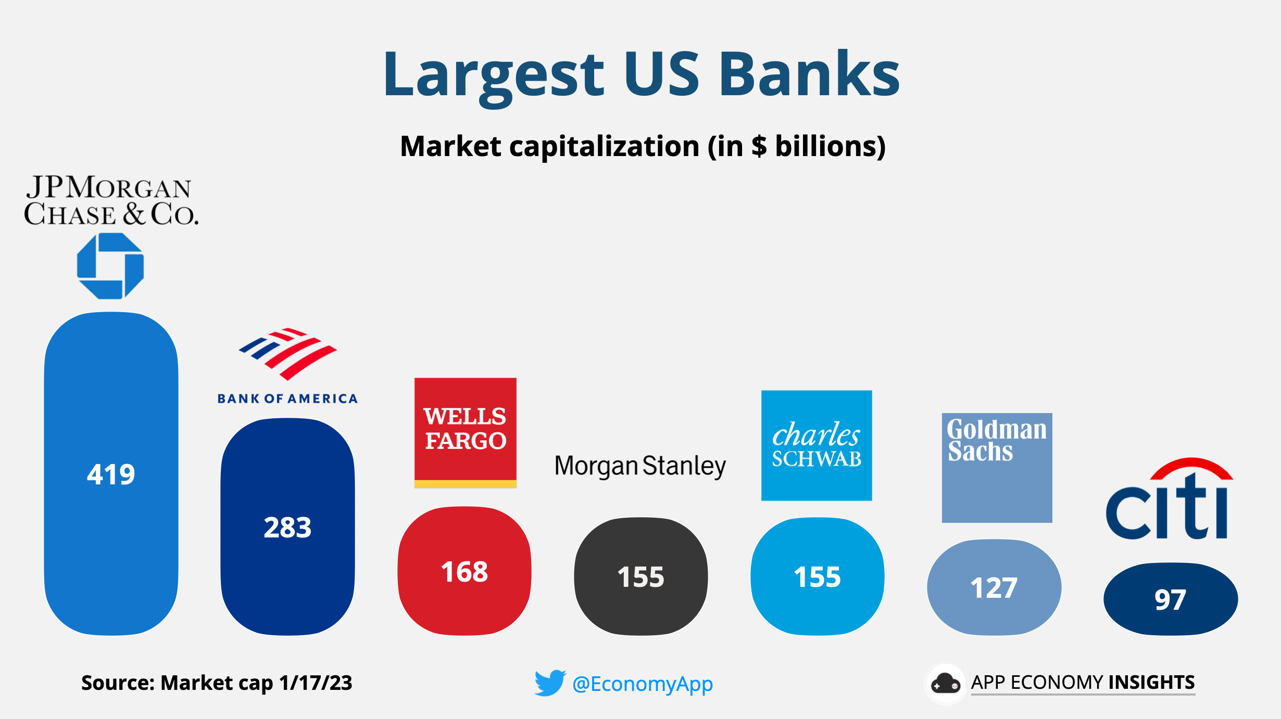
Industrial Competitors
Notes:
Top 10 Banks of USA – Closest competitors by Market Capitalisation are Bank of America and Wells Fargo followed by the other major players of the industry.
Data is based on Jan 17th 2023.
Source https://www.appeconomyinsights.com/

Slide 11
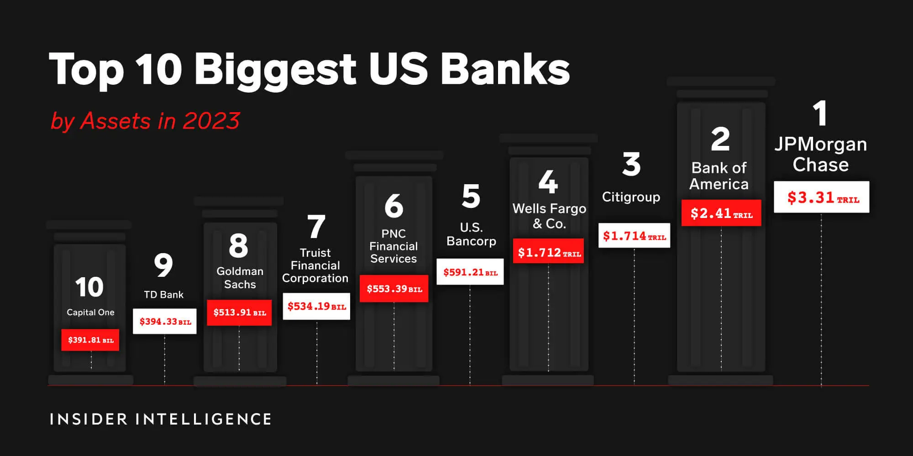
Industrial Competitors
Notes:
Top 10 Banks of USA – Closest competitors by Assets size are Bank of America and Citigroup followed by the other major players of the industry.

Slide 12
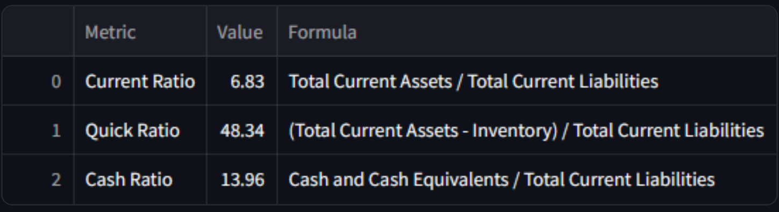
Financial Ratio Analysis
Liquidity Ratio
Current Ratio: Ratio between 1.5 and 3 is considered healthy.
With a current ratio of 6.83, the company is well above the standard, which may suggest inefficient use of assets.
Quick Ratio: Ratio Above 1 or above is good.
A ratio much higher than 1, 48.34, is far beyond normal expectations and might suggest an excessive amount of liquidity or underutilization of assets.
Cash Ratio:
13.96 is exceptionally high, suggesting that the company holds an unusually large amount of cash.
Notes:
Current Ratio: Below 1, a company may struggle to meet its short-term liabilities; above 3, it might not be using its current assets efficiently.
Quick Ratio: A quick ratio of 1 or above is typically seen as good, as it indicates that the company can pay off its immediate liabilities without selling any inventory.
Cash Ratio: A standard cash ratio is often a lot lower, usually around 0.5 to 1, since holding a lot of cash can be seen as not using capital effectively.

Slide 13
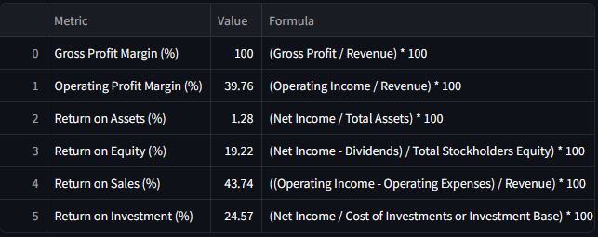
Financial Ratio Analysis
Profitability Ratio
Gross Profit Margin (100%): This rate is very high. It suggests that all revenue is gross profit for bank.
Operating Profit Margin (39.76%): The company keeps about 40 cents as profit from every dollar it makes, which is good.
Return on Assets (1.28%): The company doesn't make much money from what it owns, like buildings and machines.
Return on Equity (19.22%): Investors get a 19-cent return for every dollar they have in the company, which is pretty good.
Return on Sales (43.74%): For every dollar from sales, the company makes about 44 cents in profit, which is a strong performance.
Return on Investment (24.57%): The company earns about 25 cents for every dollar it invests, which is a healthy profit.
Notes:
Profitability ratios assess a company's ability to earn profits from its sales or operations, balance sheet assets, or shareholders' equity..

Slide 14
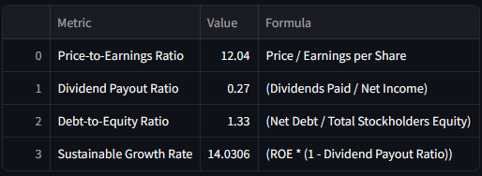
Financial Ratio Analysis
Earnings Ratio
Price-to-Earnings Ratio (12.04): The price of the company's stock is 12 times more than what the company earns for each share. This means the stock might be priced just right, not too expensive or too cheap based on its earnings.
Dividend Payout Ratio (0.27): The company gives 27% of its profit to the shareholders as dividends. It's keeping the rest to use in the business.
Debt-to-Equity Ratio (1.33): For every dollar the company's owners have put in the company has $1.33 in debt. This suggests it uses a mix of its money and borrowed money to run.
Sustainable Growth Rate (14.0306%): The company could grow its business by 14% every year without having to borrow more money or sell more shares, as long as it continues paying dividends like it is now. This means the company is doing well and can grow nicely.

Slide 15
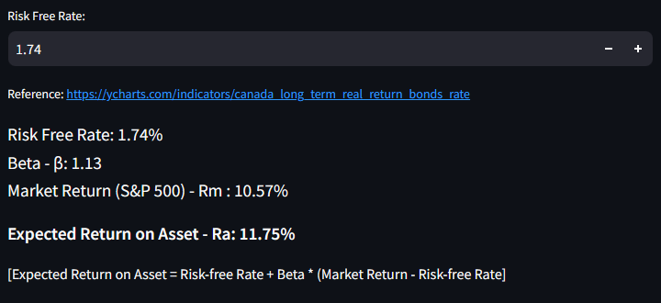
Capital Asset Pricing Model - CAPM
The expected return on the asset (11.75%) is higher than the risk-free rate (1.74%), which is what you would expect for an investment with some risk.
The beta of the asset (1.13) is slightly higher than 1, which means the asset is expected to be slightly more volatile than the market.
It is important to note that this is just a theoretical calculation of the expected return based on CAPM.
Notes:
Capital Asset Pricing Model is a mathematical, financial model that calculates the expected rate of return for an asset or investment.
CAPM does this by using the expected return on both the market and a risk-free asset, and the asset's correlation or sensitivity to the market, the beta value.
Main components of CAPM are Risk Free Rate (RF) , Beta, Market Return (RM)
CAPM – Expected Return on Asset – RA = RF + Beta*(Rm = Rf)

Slide 16
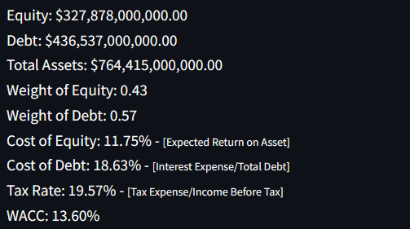
Weighted Average Cost of Capital - WACC
Equity ($327.878 billion): This is a substantial amount, showing the company has a solid base of funding from shareholders.
Debt ($436.537 billion): The company carries a larger debt compared to its equity, indicating a heavy reliance on borrowed funds.
Total Assets ($764.415 billion): Sum of Equity and Debt.
Weight of Equity (0.43): Equity constitutes 43% of the firm's financing structure, showing a substantial stake for shareholders.
Weight of Debt (0.57): Debt makes up 57% of the financing, suggesting a lean towards borrowing over equity.
Cost of Equity (11.75%): Investors expect an 11.75% return on their investment. (Taken from CAPM)
Cost of Debt (18.63%): The company pays a high interest rate on its debt, which can be expensive over time.
Tax Rate (19.57%): The company’s profits are taxed at a rate of 19.57%.
WACC (13.60%): Overall, the company’s average cost for the money it uses is 13.60%
Notes:
WACC represents a company's average cost of capital from all sources, including common stock, preferred stock, bonds, and other forms of debt.
WACC is the average rate that a company expects to pay to finance its business.

Slide 17

Monte Carlo Simulation
Monte Carlo simulation technique is named after the Monte Carlo Casino in Monaco.
A Monte Carlo simulation is used to model the probability of different outcomes in a process that cannot easily be predicted due to the random variables.
It is a technique used to understand the impact of risk and uncertainty.
Monte Carlo simulation predicts outcomes with random variables, helping to understand risk and uncertainty in forecasts.
In finance, the use of Monte Carlo simulations became prominent in the latter part of the 20th century for modeling complex financial instruments, risk management, and portfolio optimization.
Notes:
The Monte Carlo simulation technique is named after the Monte Carlo Casino in Monaco and was first developed in the 1940s by scientists working on the Manhattan Project.
It was initially used to model the behavior of neutrons in nuclear reactions.
However, its applications quickly expanded beyond nuclear physics.

Slide 18
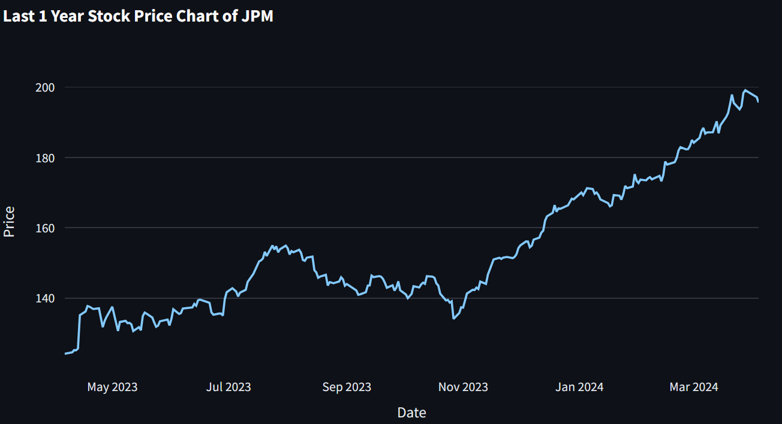
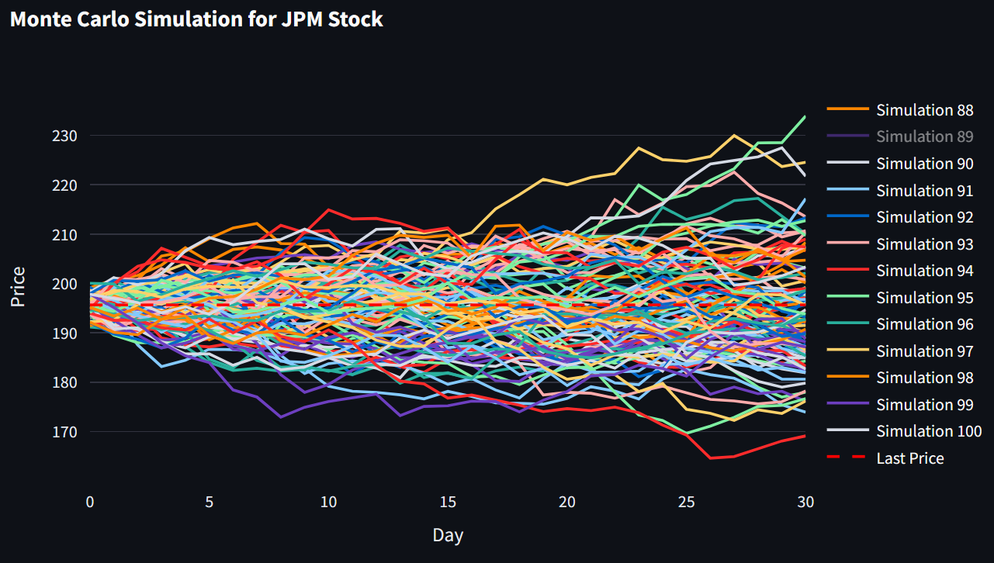
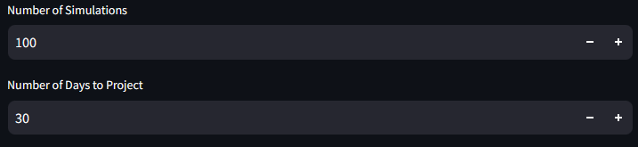
Monte Carlo Simulation
Notes:
Stock Price for the last year – 100 simulations for the next 30 days

Slide 19

Facebook Prophet
Prophet is an open-source forecasting tool developed by Facebook's Core Data Science team, designed to make accurate time series forecasting accessible to non-experts.
It's built on a decomposable time series model with three main components: trend, seasonality, and holidays.
Prophet automatically detects and handles missing data, outliers, and changes in trend or seasonality.
Prophet has gained popularity for its simplicity, flexibility, and ability to generate reliable forecasts for various types of time series data, from business metrics to weather patterns.

Slide 20
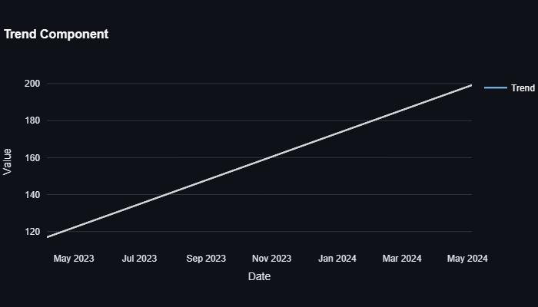
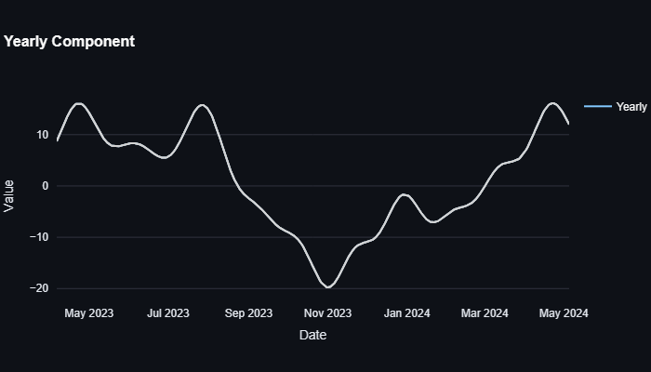
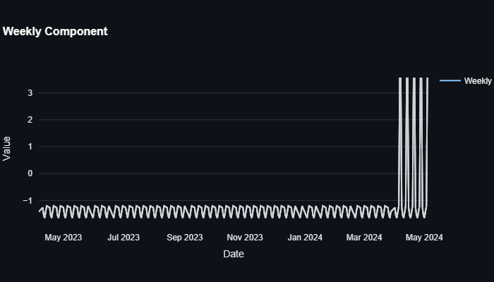
Facebook Prophet
Notes:
These are the Fb Prophet - Trend, Yearly and Weekly components.
Trend component: This graph shows the overall upward trend in stock price over the last year.
Yearly component: This graph shows the seasonal variation throughout the year. We can observe the peak around May and low point around November.

Slide 21
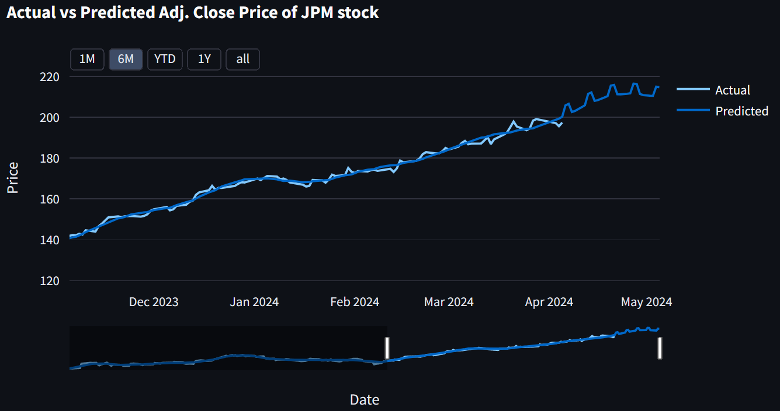
Facebook Prophet
Notes:
Price of JP Morgan was around $140 in December 2023 and price steadily increased to $200 by April 2024.
Fb Prophet model predicts the stock price to reach by 220 in the next 30 days by ending of May 2024.

Slide 22
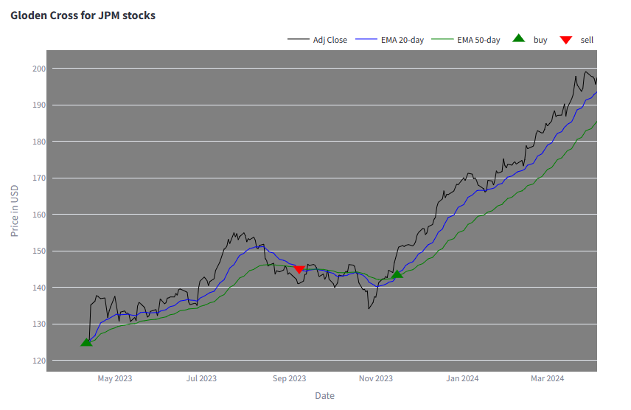
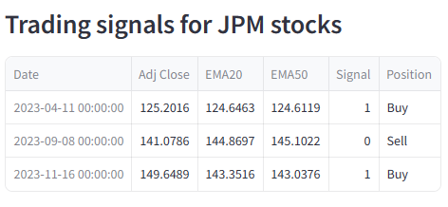
Golden Crossover – Trading Signals
Notes:
20 day and 50 day Exponential Moving average is plotted to check for the golden cross buy or sell signals.
We identified 3 opportunities for buy and sell in the last 1 year for JP Morgan Stock.
The table shows the date on which the signal is generated with the direction whether to buy or sell.

Slide 23
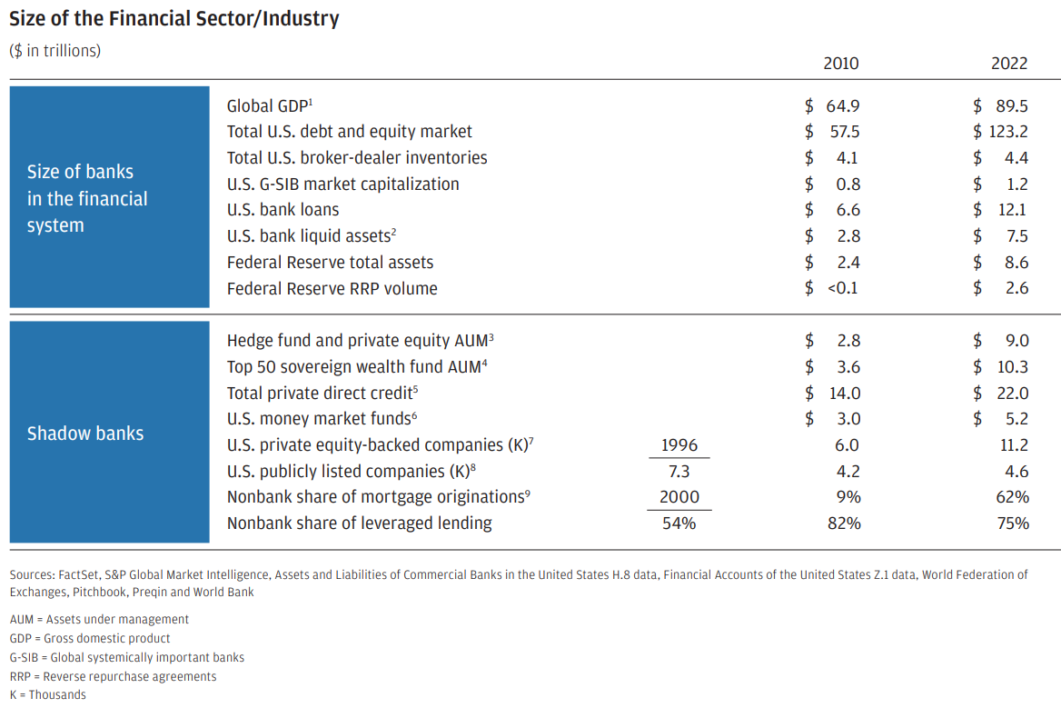
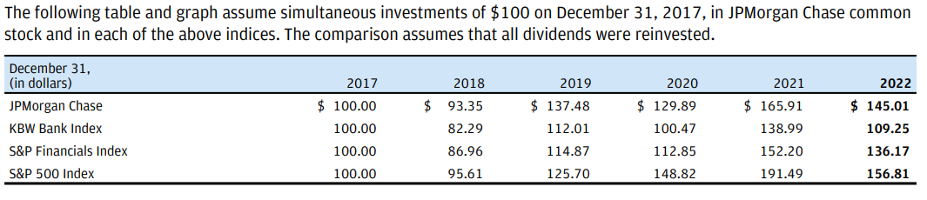
Industry Growth
Notes:
Change in the Financial sector or industry from 2010 to 2022.
Growth has been significant.
It is evident that size of banks is growing along with the economy.
100$ Investment comparison with various indices.

Slide 24
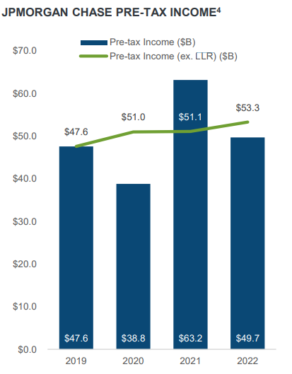
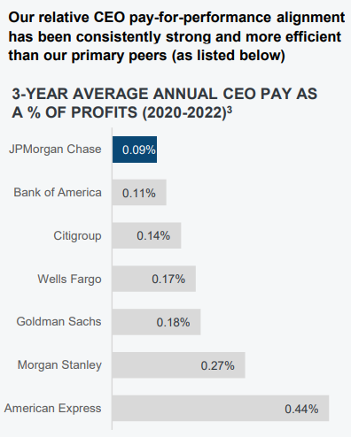
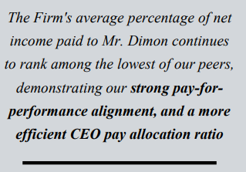
Company Performance and CEO Pay
Notes:
JP Morgan’s pre-tax income has been growing steadily except for the year 2020 due to pandemic and business shutdown.
One noteworthy statistic is that JP Morgan’s CEO’s 3 Year – Average Annual CEO pay is lowest amongst the peers.

Slide 25
Findings
Performance: JPM has a track record of consistent robust earnings and growth, benefiting from its diversified business across various financial sectors.
Diversification: Its operations include retail, commercial, asset management, and investment banking, reducing risk by not relying on a single revenue source.
Worldwide Operations: With a presence in over 100 countries, JPM's global footprint allows it to tap into international markets and mitigate domestic downturns.
Tech Innovation: Significant investments in digital banking and technology position JPM ahead in the evolving financial landscape.
Financial Health: JPM's strong capital position enables it to offer steady dividends, appealing to income-seeking investors.

Slide 26
Conclusion
Based on the analysis conducted and the price forecast for JP Morgan and Chase:
Stock is relatively overvalued (High Price earnings ratio) when compared with peers but future growth prospects, profitability and market leadership in the banking industry make the stock attractive.
Existing Investors can hold the stock for long term as a portfolio stock.
Potential new investors can buy the stock whenever the stock price falls during market corrections.

Slide 27
References
Investopedia
Annual Reports of the company
Financial Modelling Prep API documentation
Yahoo Finance Python Package
Insider Intelligence
App Economy Insights

Slide 28
Thank you
Professor
and
everyone.

Slide 29

Thank you
Professor
and
everyone.

Slide 30
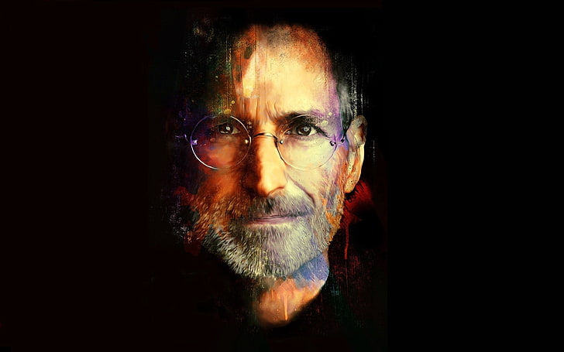
One More Thing…
Notes:
Like Steve Jobs says -

Slide 31
Web App
Walkthrough

